Slide 1
Markov Chain

Slide 2
What is Markov Chain ?
These are special kind of stochastic processes, where outcome of an experiment depends only on outcome of the previous experiment. In other words next state of the system depends only on present state and not on preceding states.
A stochastic processes is a mathematical model that evolve over the time in probabilistic manner.
Markov chains are usually described by directed graphs where edges of graph are labelled by the probabilities of going from one state at time n to other state at time n+1..
Probability of state 3 at time t going in state 2 at time t+1 is 0.36

Slide 3
State Transition Matrix
It is square Matrix as all possible states must be used as rows as well as columns
All Entries are between 0 and 1 as they represent probabilities
Sum of the entries in a row must be 1 as it represents probability of going state 1 to other in next interval of time.

Slide 4
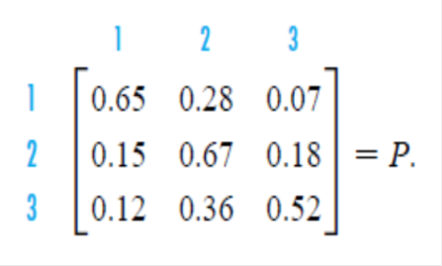
Transition Matrix
Lets find out the probability of system to be in state 3 after 2 time intervals string in tat state 2
Matrix Multiplication
P^{k} gives the probabilities of a transition from one state to another in k repetitions of an experiment.

Slide 5
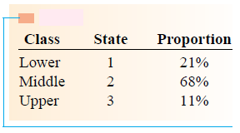
Example
Suppose Initial distribution of the of people in three different income class
To find the proportion of people in state 2 after one generation we need to add numbers marked with arrow.
= 55 %
= 19 %
Proportion of people in state 1 after one generation
= 25 %
In Matrix form
Proportion of people in state 3 after one generation
= 19 %

Slide 6
Example cont….
Distribution of Income Class after two generation is initial probability vector multiplied by Square of transition matrix
With initial probability vector [ 0.75, 0.15 0.1]

Slide 7
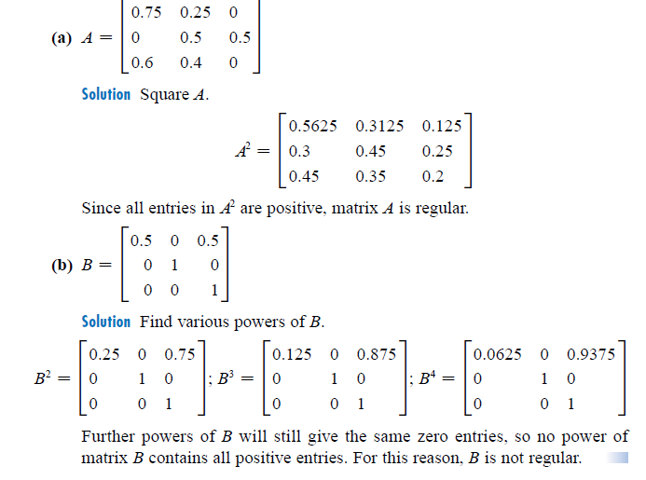
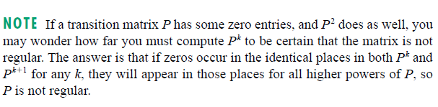
Long Range Predictions
One of many applications of Markov Chains is in finding Long Range Predictions.
Long Range Predictions are possible with only Regular Transition Matrices.
A matrix is Regular Matrix if some power of Matrix contains all positive entries

Slide 8
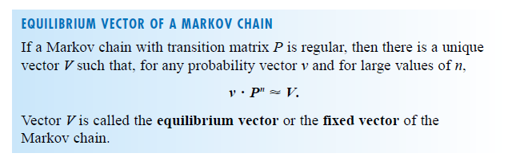
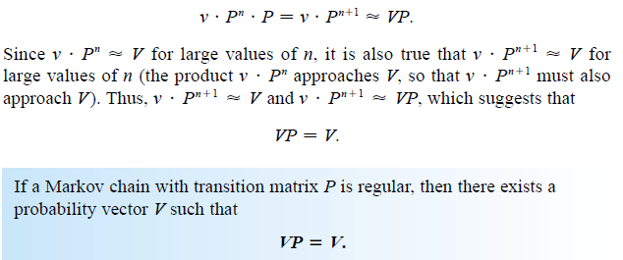

Slide 9
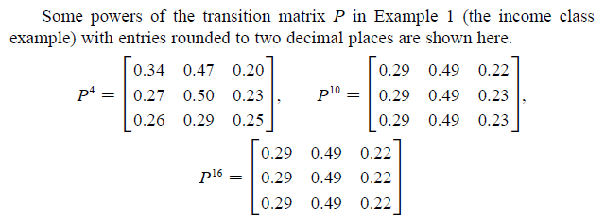
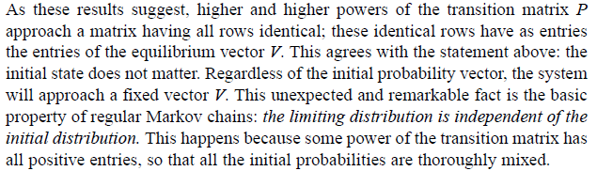

Slide 10
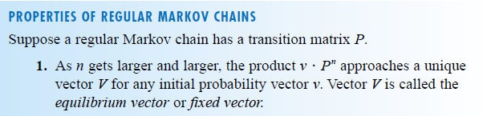
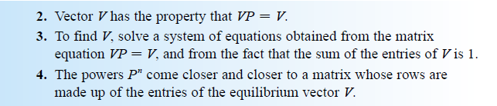
Properties of Markov Chain

Slide 11
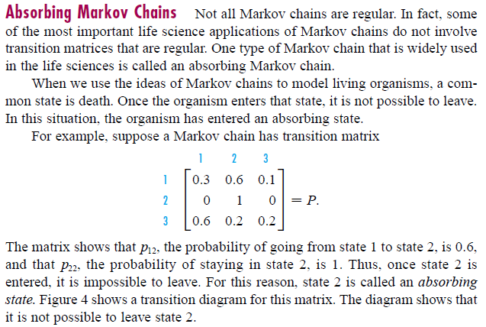
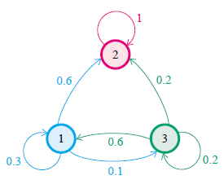
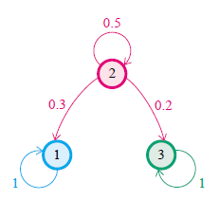
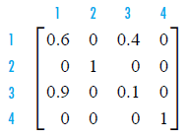
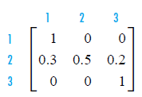
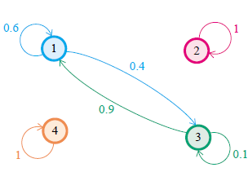
Absorbing Markov Chain

Slide 12
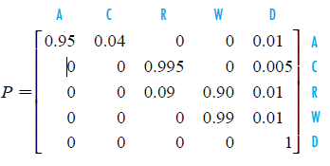
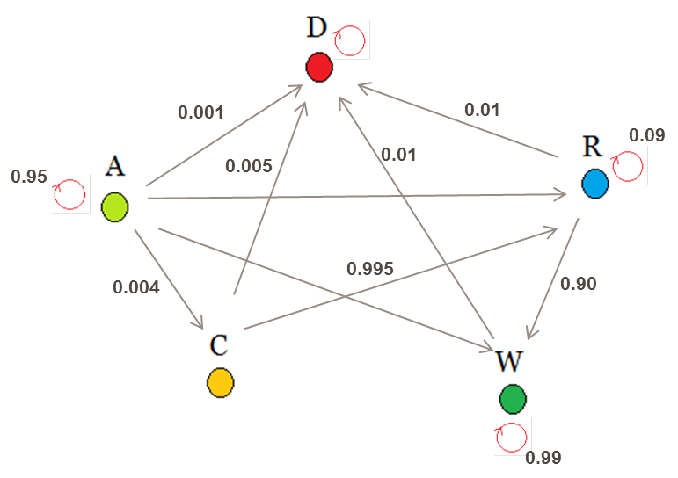
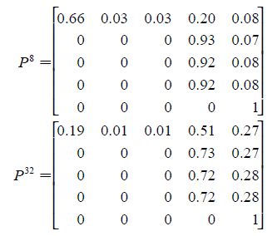
Example : Management of Gallstone
Physicians who diagnose asymptotic gallstone are faced with the decision either immediately remove gall bladder to prevent life threatening complications or to postpone surgery until complications do occur. SO what should be the long term trend of each strategy?
A : Is state of Asymptotic Gallstone and let probability of the patient wd remain in the same state for next 4 month is 0.95
C : Is state major complications Cholecystitis may result with probability 0.04
D : State of natural death Say its probability is 0.01
If disease progress then surgery is performed with a risk of death due to surgery 0.005. Once surgery is performed patient enter the state of recovery state R
90 % move to Well state (W) and 9 % continue in recovered state and 1 % die natural death
Once patient enter the well state there she continues there until death with probability of 0.99
For the long term trend of this strategy, when matrix is raised to higher and higher power system will tend to the Absorbing State

Slide 13
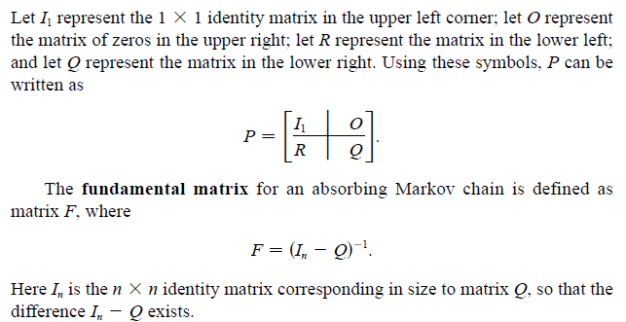
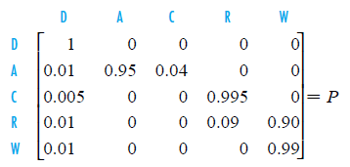
Example cont..
Method of finding the final probabilities of entering an absorbing state without finding all the powers of transition matrix
We do not really need to worry about the absorbing state, so it is necessary to work only with the non-absorbing states
Rewrite the matrix so that the rows and columns corresponding to the absorbing state comes first

Slide 14
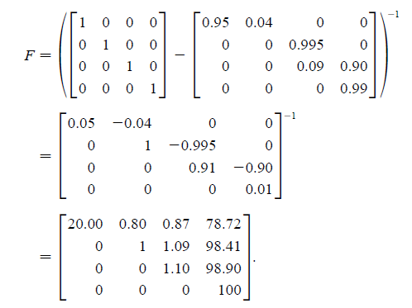
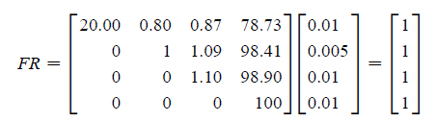

Example cont..
Fundamental Matrix F gives the expected number of visits to each state before absorption occurs.
If the patient is currently in asymptotic , first row of fundamental matrix says that she expects to have 20, four-months time period (6.67 years) on average in this state
and 20.00 + 0.80+0.87+78.72 = 100.39 four-month time period in the various living state before death.
i.e her life expectancy is 100.39/3 = 33.46 years.
The product FR gives the probability that if the system was originally in a particular non absorbing state it ended up in the absorbing state. For example probability is 1 that if the patient was originally asymptotic she ended up dying, which unfortunately is what we expect

Slide 15
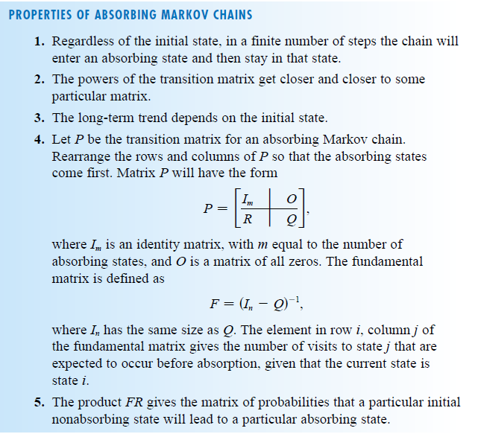
Properties of Absorbing Markov Chains

Slide 16
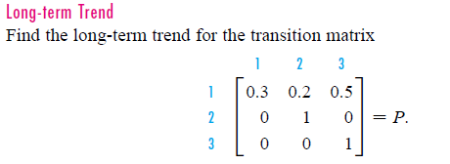

Exercise
Use formula
Find product FR

Slide 17
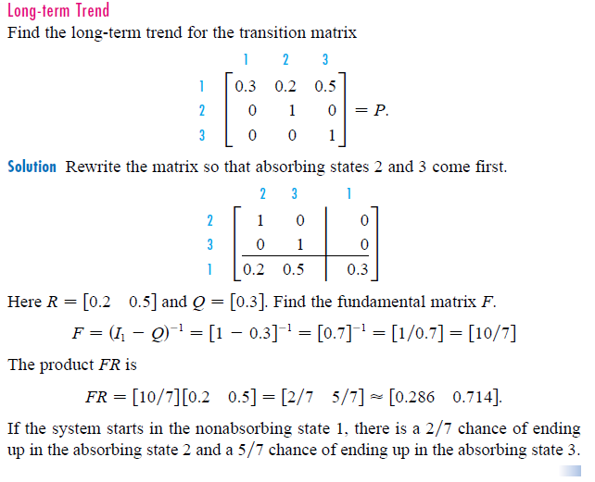
Exericse

